Slide 1
UNIT - V CHAPTER - 9
INTRODUCTION TO MYSQL

Slide 2
MySQL and client-server Technology:
MySQL falls into the client-server DBMS category. A client-server DBMS is split into two components. The server component typically resides on the same physical computer as the database files and is responsible for all interactions with the database. The second component is the client. The client sends all database requests to the server which in turn processes the request and returns the results of the request back to the client.

Slide 3
Advantages of MySQL client server technology
There are a couple of key advantages to the client-server architecture DBMS.
There is no need for the client to be running on the same computer system as the server. Instead, requests can be sent by the client over a network or internet connections to the server on a remote host.
The fact that the server resides on a remote computer is invisible to the client user. This makes the database available to greater numbers of users than a shared file DBMS offers. In large scale enterprise environments this also allows high levels of fault tolerance and load balancing to be implemented.
• Separating the client from the server allows a wider range of client types to be used to access the database. Valid clients can be the MySQL tools, applications written in other programming languages such as C, C++ or Java, or web based applications developed using languages such as PHP or JSP.

Slide 4
Data Manipulation in DBMS
SQL commands are instructions used to communicate with the database to perform specific task that work with data. SQL commands can be used not only for searching the database but also to perform various other functions like, for example, you can create tables, add data to tables, or modify data, drop the table, set permissions for users. SQL commands are grouped into four major categories depending on their functionality:

Slide 5
Data Manipulation in DBMS
• Data Definition Language (DDL) - These SQL commands are used for creating, modifying, and dropping the structure of database objects. The commands are CREATE, ALTER, DROP, RENAME, and TRUNCATE.
• Data Manipulation Language (DML) - These SQL commands are used for storing, retrieving, modifying, and deleting data. These commands are SELECT, INSERT, UPDATE, and DELETE.
• Transaction Control Language (TCL) - These SQL commands are used for managing changes affecting the data. These commands are COMMIT, ROLLBACK, and SAVEPOINT
Data Control Language (DCL) - These SQL commands are used for providing security to database objects. These commands are GRANT and REVOKE.

Slide 6
Features of MySQL
MySQL can be used by a range of users, including those with little or no programming experience.
• It is a non-procedural language.
• It reduces the amount of time required for creating and maintaining systems.
• It is an English-like language.

Slide 7
Data types in MySQL
String data types:
CHAR
The CHAR datatype stores fixed-length character strings. When you create a table with a CHAR column, you must specify a string length (in bytes or characters) between 1 and 2000 bytes for the CHAR column width. The default is 1 byte. MySQL then guarantees that: When you insert or update a row in the table, the value for the CHAR column has the fixed length.
• If you give a shorter value, then the value is blank-padded to the fixed length.
• If a value is too large, MySQL Database returns an error.

Slide 8
VARCHAR
The VARCHAR data type stores variable-length character strings. When you create a table with a VARCHAR column, you specify a maximum string length (in bytes or characters). For each row, MySQL Database stores each value in the column as a variable-length field unless a value exceeds the column's maximum length, in which case MySQL Database returns an error. For example, VARCHAR(25), You must define a length when creating a VARCHAR field.

Slide 9
TEXT
A field with a maximum length of 65535 characters. Fields defined as TEXT also hold large amounts of data.You do not specify a length with TEXT.

Slide 10
Numeric data types INT
The INT datatype stores fixed numbers and requires 4 bytes. The range of numbers that can be stored are from -2,147,483,648 to 2,147,483,647. Numbers of virtually any magnitude can be stored and are guaranteed portable among different systems operating MySQL Database, up to 38 digits of precision. For numeric columns, you can specify the column as: column_nameINT[length]

Slide 11
DECIMAL
This data type is used to store numeric values of varying length with decimal point. The storage space required is (total length + 1) bytes. Here, we can specify a length(total number of digits) and decimal places (number of digits to the right of the decimal point) as follows:
column_nameDECIMAL[Length, Decimals]

Slide 12
Date and Time Types Date
The DATE data type stores point-in-time values (dates and times) in a table. The DATE data type stores the year (including the century). This data type requires 3 bytes of memory.
For input and output of dates, the standard MySQL date format is YYYY-MM-DD e.g. 2017-12-22

Slide 13
TIME
Stores the time in a HH:MM:SS format.

Slide 14
SQL Commands
A MySQL database server contains many databases (or schemas).
Each database consists of one or more tables. A table is made up of columns (or fields) and rows (records).
The SQL keywords and commands are NOT case-sensitive. For clarity, they are shown in uppercase.
SQL commands are instructions. It is used to communicate with the database. It is also used to perform specific tasks, functions, and queries of data.SQL can perform various tasks like create a table, add data to tables, drop the table, modify the table, set permission for users.

Slide 15
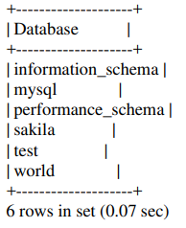
SHOW DATABASES
You can use SHOW DATABASES to list all the existing databases in the server.
mysql> show databases;

Slide 16
The databases "mysql", "information_schema" and "performance_schema" are system databases used internally by MySQL. A "test" database is provided during installation for your testing.

Slide 17
CREATE DATABASE and DROP DATABASE
Purpose:
You can create a new database using SQL command "CREATE DATABASE databaseName"; and delete a database using "DROP DATABASE databaseName". You could optionally apply condition "IF EXISTS" or "IF NOT EXISTS" to these commands

Slide 18
CREATE DATABASE and DROP DATABASE
mysql> CREATE DATABASE jahnavi;
Query OK, 1 row affected (0.03 sec)
mysql> DROP DATABASE jahnavi;
Query OK, 0 rows affected (0.11 sec)
mysql> CREATE DATABASE IF NOT EXISTS jahnavi;
Query OK, 1 row affected (0.01 sec)

Slide 19
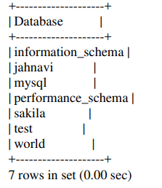
CREATE DATABASE and DROP DATABASE
mysql> show databases;

Slide 20
CREATE AND DROP TABLES
Purpose:
The CREATE TABLE statement is used to create a new table in the database. Tables are defined in part by the columns they contain. Each column has a specific data type which specifies how data is stored in the column. When creating a new table, you must decide on the appropriate data type of the column. These data types are then specified in the CREATE TABLE Statement.

Slide 21
Syntax:
a. The general format of CREATE command is
CREATE TABLE tablename
(column1 data type(size),
column2 data type(size),
column3 data type(size),
:
column-n data type(size));

Slide 22
Syntax:
b. We can create a table from another table in SQL. The syntax is as follows

Slide 23
a. Create a table called student that contains roll number, name and marks in three subjects
mysql> use raksha;
Database changed

Slide 24
a. Create a table called student that contains roll number, name and marks in three subjects
mysql> create table student
-> (rollno int(2),
-> name varchar(15),
-> m1 int(2),
-> m2 int(2),
-> m3 int(2));
Query OK, 0 rows affected (0.14 sec)

Slide 25
b. Create a table named sample from the existing table student that contains only rollno and names of students
mysql> create table sample(rollno, name)
->as select rollno,name from student;
Query OK, 0 rows affected (0.14 sec)

Slide 26
c. Create a table named sample1 that contains the same structure as student but with no records
mysql> create table sample1
-> as select * from student where 1=2;
Query OK, 0 rows affected (0.14 sec)

Slide 27
INSERT
Purpose:
The INSERT statement is used to insert records into a table. This statement loads the table with data to be manipulated later. When inserting a single row into the table the insert operation does the following:
• Creates a new row in the database table
• Loads the values passed into the columns specified
Character data type values must be enclosed in single quotes(‘).

Slide 28

Syntax:
Example:
mysql> insert into student
-> values(01,'Rama',89,70,75);
Query OK, 1 row affected (0.04 sec)

Slide 29
Syntax
Insert multiple rows in one command
mysql> insert into student
-> values(01,'Rama',89,70,75),
-> (2,’Bheem’,80,70,65);
Query OK, 2 rows affected (0.03 sec)
Records: 2 Duplicates: 0 Warnings: 0

Slide 30
SELECT
Purpose:
Once data is inserted into the tables, the next logical operation would be to view the data that has been inserted. The SELECT verb in SQL is used to achieve this. The SELECT command is used to retrieve rows from one or more table

Slide 31
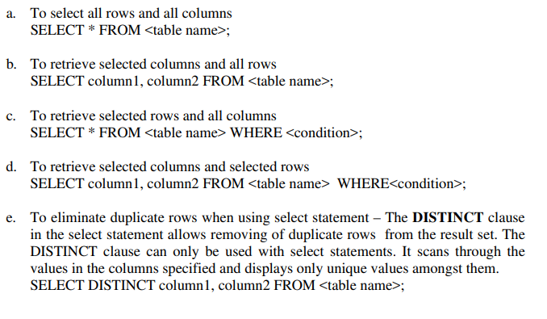
Syntax:

Slide 32
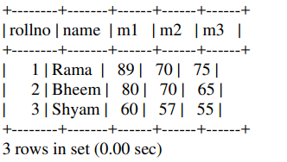
Example:
a. Display the details of all the students
mysql> select * from student;

Slide 33
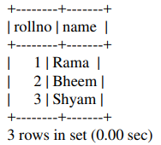
Example:
b. Display the roll number and names of all the students
mysql> select rollno,name from student;

Slide 34
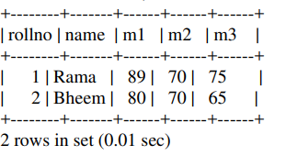
Example
c. Display the details of students who got more than 75 in subject 1
mysql> select * from student
-> where m1>75;

Slide 35
DELETE
Purpose:
The DELETE command is used to delete rows from a table that satisfies the condition and returns the number of records that were deleted. If the DELETE command is executed without a WHERE clause then, all rows are deleted. This verb either deletes all the rows or a set of rows in a given table

Slide 36

DELETE
Syntax:

Slide 37
DELETE
Example:
a. Remove the all details of student named Raja
mysql> delete from student where name='Raja’;
query ok. 1 row affected.
b. delete all the records
mysql> delete from student;
query ok. 3 row affected.

Slide 38
ALTER
Purpose:
The structure of a table can be modified by using the ALTER TABLE command. ALTER TABLE allows the user to change the structure of the existing table. With ALTER TABLE command it is possible to
• Add or delete the columns
• Create or destroy indexes
• Change the data type of existing columns
• Rename columns or table itself
ALTER TABLE works by making a temporary copy of the original table. The alteration is performed on the copy, then original table is deleted and the new one is modified.

Slide 39
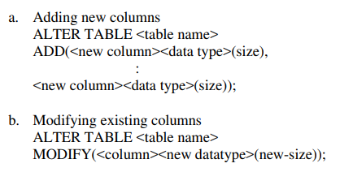
ALTER
Syntax:

Slide 40
Example:
a. Add a new column Total with data type number and size 2.
mysql> alter table student ->add (total number (2));
Query OK, 3 rows affected (0.17 sec)
Records: 3 Duplicates: 0 Warnings: 0

Slide 41
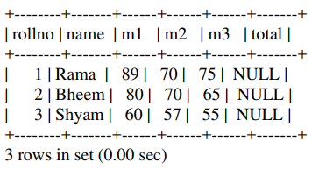
ALTER
mysql> select * from student;
b. Change the size of total to 3
mysql> alter table student
-> modify (total number (3));

Slide 42
UPDATE
Purpose:
The UPDATE command is used to change or modify data values in a table. The UPDATE verb in MYSQL is used to either update all the rows or selected rows in a table. The UPDATE statement updates columns in the existing table’s rows with new values. The SET clause indicates which column data should be modified and the new values they should hold. The WHERE clause, if given, specifies which rows should be updated. Otherwise all the rows are updated.

Slide 43
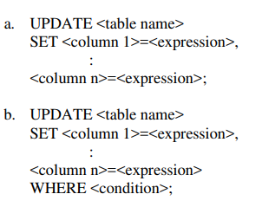
UPDATE
Syntax:

Slide 44
UPDATE
Example:
a. Increment the marks of all students by 10 in subject2
mysql> update student set m2=m2+10;
Query OK, 3 rows affected (0.03 sec)
Rows matched: 3 Changed: 3 Warnings: 0

Slide 45
UPDATE
b. Update the total of all the students
mysql> update student
-> set total=m1+m2+m3;
Query OK, 3 rows affected (0.03 sec)
Rows matched: 3 Changed: 3 Warnings: 0

Slide 46
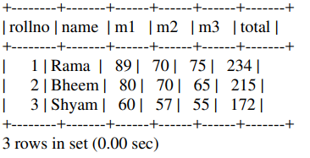
UPDATE
mysql> select * from student;

Slide 47

RENAME
Purpose:
RENAME command is used to rename or give another name to the existing table.
Syntax:

Slide 48
RENAME
Example:
mysql> rename student to student1;
Table renamed.

Slide 49
DESCRIBE
Purpose:
The DESCRIBE command is used to display the structure of a table. This command displays the column names, the data types and the special attributes that are connected to the table.

Slide 50

DESCRIBE
Syntax:

Slide 51

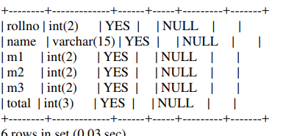
DESCRIBE
Example:
mysql> describe student;

Slide 52

DROP
Purpose:
The DROP TABLE statement is used to destroy a specific table. If a table is dropped all the records held within it are lost can cannot be recovered.
Syntax:

Slide 53
DROP
Example:
mysql> drop table student1;
Query OK, 0 rows affected (0.14 sec)

Slide 54
Computations on table data:
Generally there are three types of operators in SQL:
SQL Arithmetic Operators
SQL Comparison Operators
SQL Logical Operators

Slide 55
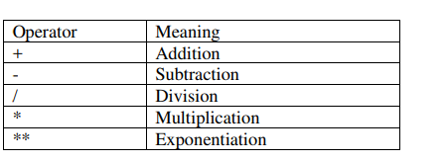
Arithmetic Operators:
The various arithmetic operators are as follows:

Slide 56
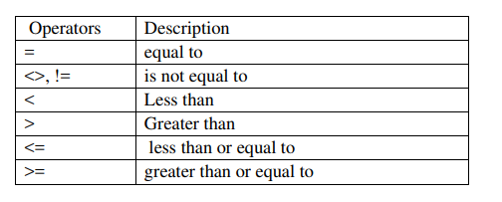
Comparison Operators:
Comparison operators are used to compare the column data with specific values in a condition. Comparison Operators are also used along with the SELECT statement to filter data based on specific conditions. The below table describes each comparison operator.

Slide 57

Comparison Operators:
a. List the roll number and names student whose total is more than 200 mysql> select rollno,name from student
->where total>200;

Slide 58
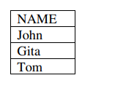
Comparison Operators:
b. List the names of students who secured less than 50 in subject1.
mysql> select name from student
->where m1<50;

Slide 59
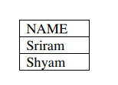
Comparison Operators:
c. List the names of students who got more than or equal to 70 in subject3 mysql> select name from student
->where m3>=70;

Slide 60
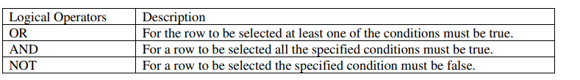
Logical operators
There are three Logical Operators namely, AND, OR, and NOT. These operators compare two conditions at a time to determine whether a row can be selected for the output. Logical operators are used in the WHERE clause and allows you to combine more than one condition.

Slide 61

Logical operators
a. List the details of students who secured more than 60 in subject 1 and subject 2
mysql> select * from student where m1>60 and m2>60;

Slide 62
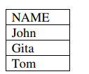
Logical operators
List the names of students who secured less than 50 in any subject.
mysql> select name from student where m1<50;

Slide 63
Range Searching
In order to select data that is within a range of values, the BETWEEN operator is used. The BETWEEN operator allows the selection of rows that contain values within a specified lower and upper limit. The two values in between the range must be linked with a keyword AND. The BETWEEN operator can be used with both character and numeric data types.

Slide 64
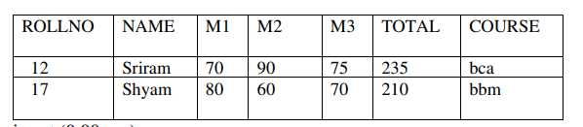
a. List the details of students whose total is in the range 180 and 250.
mysql> select * from student where total between 180 and 250;

Slide 65
Pattern Matching LIKE Operator
The LIKE operator is used to list all rows in a table whose column values match a specified pattern.
It is useful when you want to search rows to match a specific pattern, or when you do not know the entire value.
For this purpose we use a the following wildcard character
• % allows to match any string of any length
• _ allows to match on a single character.

Slide 66
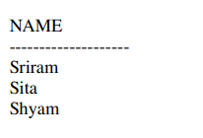
LIKE Operator
a. List the names of students whose name begins with ‘S’.
mysql> select name from student where name like 'S%’

Slide 67

LIKE Operator
List the name and roll number of students whose name ends with ‘a’. mysql> select rollno,name from student where name like '%a';

Slide 68
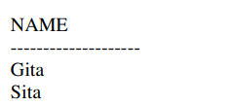
LIKE Operator
List the names of students who have ‘i’ as the second letter in their name. mysql> select name from student where name like '_i%’;

Slide 69
IN and NOT IN
The arithmetic operator (=) compares a single value to another single value. In case a value needs to be compared to a list of values then the IN predicate is used. It reduces the need to use multiple OR conditions in a query.

Slide 70
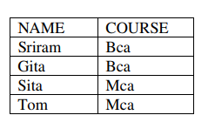
IN and NOT IN
a. List the student names and course who are studying either mca or bca. mysql> select name, course from student where course in ('mca','bca’);

Slide 71
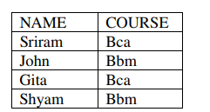
IN and NOT IN
b. List the student names along with their course who are not studying mca. mysql> select name, course from student where course not in ('mca');

Slide 72

SELECT without Table
You can also issue SELECT without a table. For example, you can SELECT an expression or evaluate a built-in function.
mysql> SELECT 1+1;

Slide 73


SELECT without Table
mysql> SELECT NOW();

Slide 74
Built-in Functions in MYSQL:
Built-in functions serve the purpose of manipulating data items and returning the result
These functions can be classified depending on whether they operate on a single row or a group of rows. Oracle functions can be classified as
• Group Functions or Aggregate Functions
• Scalar functions or single row functions

Slide 75
Group Functions (Aggregate Functions)
Functions that act on a set of values are called group functions. A group function returns a single result row for a group of queried rows. An aggregate function performs a calculation on multiple values and returns a single value.

Slide 76
Group Functions
A list of group functions with examples is given below.
1) COUNT The COUNT function returns the total number of values in the specified field. Returns the number of rows in a table. It works on both numeric and non-numeric data types.
2) SUM SUM function which returns the sum of all the values in the specified column.
3) AVG Returns the average of the values in a column.
4) MIN Returns the minimum value in a given column
5) MAX Returns the maximum value in a given column

Slide 77
AVG
AVG – Returns the average of the values in a column
E.g. Display the average total of all the students
mysql> select avg(total) as “Average” from student;
Average
---------------
171.666667

Slide 78
MAX
MAX – Returns the maximum value in a given column
E.g. Display the maximum total from student table
mysql> select max(total) as "Maximum Total" from student;
Maximum Total
--------------------
235

Slide 79
MIN
MIN – Returns the minimum value in a given column
E.g. Display the minimum total from student table
mysql> select min(total) as "Minimum Total" from student;
Minimum Total
-------------------
100

Slide 80
COUNT
COUNT – Returns the number of rows in a table
E.g. Display the number of students in student table
mysql> select count(*) from student;
COUNT(*)
--------------
6

Slide 81
SUM
SUM – Returns the sum of values in a given column
E.g. Display the sum total of marks in subject1 from student table
mysql> select sum(m1) as “Marks in Subject1" from student;
Marks in Subject1
----------------------
295

Slide 82
Scalar Functions (Single row Functions)
Functions that act only on one value at a time are called scalar functions. A single row function returns one result for every row of a queried table.
String function
Numeric function
Date function

Slide 83
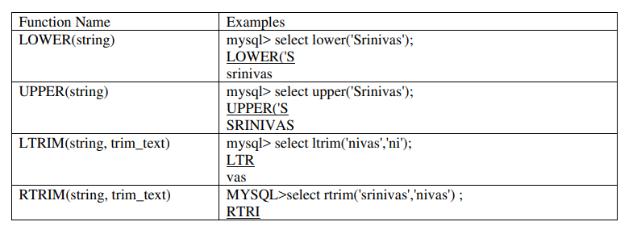
String Functions:
String functions are used to manipulate text strings.

Slide 84
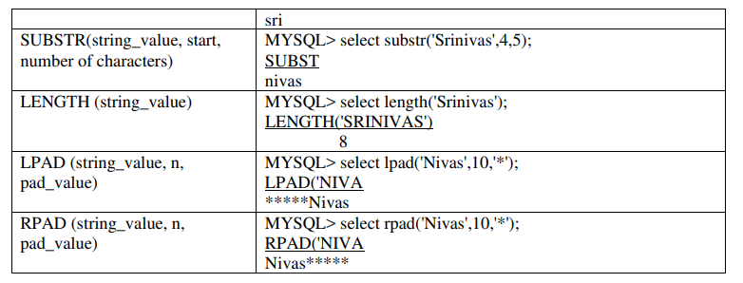
String Functions:

Slide 85
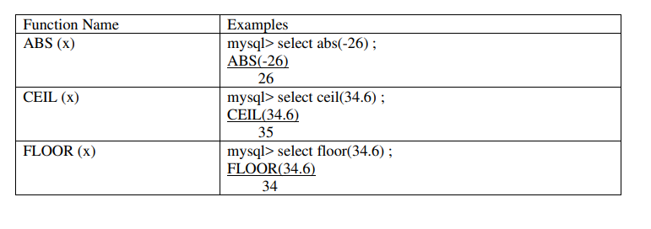
Numeric Functions:
Numeric functions are used to perform operations on numbers

Slide 86
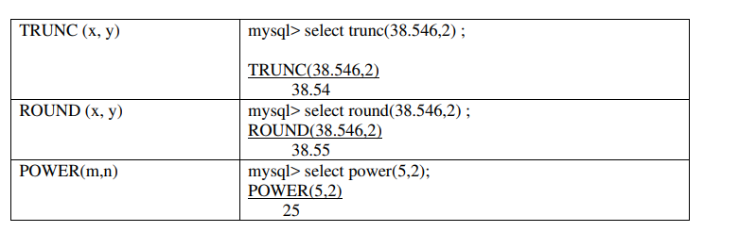
Numeric Functions:

Slide 87
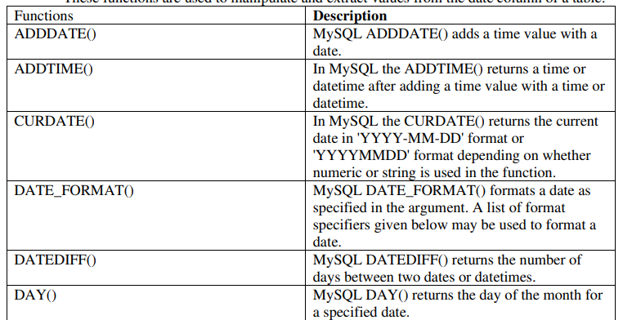
Date Functions:

Slide 88
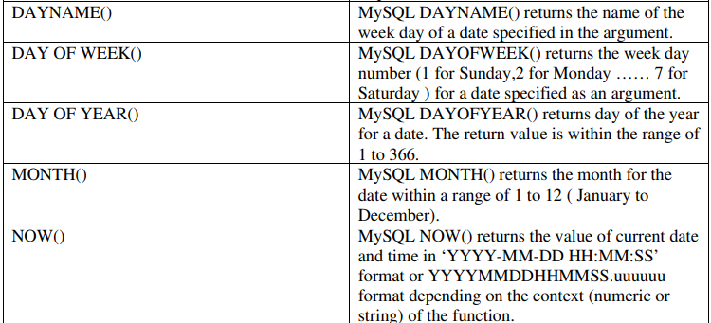
Date Functions:

Slide 89
Data Constraints on a table:
There are two types of data constraints that can be applied to data being inserted into a table.
I/O constraint
Business rule constraint

Slide 90
I/O constraints
Constraints that control data insertion and data retrieval speed are known as I/O (Input-Output) constraints.
➢ Primary key constraint
➢ Foreign key constraint
➢ Unique key constraint
➢ Not Null

Slide 91
Primary Key:
Primary key is used to identify a record uniquely from the database table. A primary key means UNIQUE + NOT NULL. Value must be available for the column on which primary key has been defined. User cannot leave the field blank. It cannot contain duplicate values. Primary key can be defined either at table level or at column level. Primary key keyword is used to define primary key constraint

Slide 92
Foreign Key:
A foreign key constraint is used to establish logical relationship between two or more tables. Foreign key is also known as referential key. It can be defined using the keyword “references”. Normally we can establish relationship between two or more tables by using some common fields. Generally a primary key is considered for defining relationship with other tables. The main table which is logically linked with other table is known as ‘Parent table’ or “master table” while other table is referred to as ‘Child table’ or “detail table”. The following point should be kept in the mind while defining foreign key.
• Data type and size of the parent table and child table should be the same.
• Record can be inserted in detail table only if relevant record is available into the master table that means while inserting record first we need to insert record into the parent table then and then we can insert record into the child table.
To delete a specific record, first we need to delete a relevant record from the detail table and after that record can be deleted from the parent table.

Slide 93
Unique Key:
A unique key constraint can be defined when we do not want the user to enter duplicate values. A unique constraint allows only unique value to be inserted. However it allows null value to be inserted. If the value is present for the unique constraint field then it must be unique. Similar to not null constraint unique key can also be define on multiple columns. “unique” keyword is use to define unique constraint.

Slide 94
Not Null:
We can define not null constraint when we do not want the user to leave the field blank. When any column contains not null constraint, the user must have to insert value for the column and it cannot be left blank. However it allows duplicate value. A table can contain not null constraint on multiple columns. Not null constraint can only be defined at column level that means it cannot be defined at table level. ‘Not Null’ keyword is used to define not null constraint.

Slide 95
Business rule constraints
Business constraint defines business rules or business policy. Each organization have their specific rules about the data store.
Check constraint can be used to define business rules.

Slide 96
Check:
A CHECK constraint takes longer time to execute compare to I/O constraint. It can be define as a logical expression that returns either true or false. Each time when a new record inserted, check constraint will be evaluate and if it returns true then record will be inserted and rejected otherwise. A check constraint expression must be a logical expression. It can also be defined either at column level or at table level.

Slide 97
Example:
Create a table EMPLOYEE using MYSQL command to store details of employees such as EMPNO, NAME, DESIGNATION, DEPARTMENT, GENDER and SALARY. Specify Primary Key and NOT NULL constraints on the table and allow only ‘M’ or ‘F’ for the column GENDER. Write the following MYSQL queries :

Slide 98
Example:
mysql> create table EMPLOYEE
-> (empno varchar2(4) PRIMARY KEY,
-> name varchar2(20) NOT NULL,
-> designation varchar2(20) NOT NULL,
-> dept varchar2(20),
-> gender char(1),
-> salary number(6) NOT NULL,
-> check (gender in('M','F')));

Slide 99
Displaying User Constraints in a Table:
SHOW CREATE TABLE <table_name>;

Slide 100
Defining and dropping integrity constraints in ALTER table:
Integrity constraints can be applied to tables using the ALTER table command.
Example:
a. Make Rollno field as primary key in student table
mysql> alter table student add primary key(rollno);

Slide 101
Integrity constraints can be dropped if the constraint is no longer needed. This can be achieved by the ALTER table using the DROP clause.
Example:
a. Drop primary key constraint from student
mysql> alter table student drop primary key;

Slide 102
GROUP BY and HAVING Clause:
The GROUP BY clause tells Oracle to group rows based on distinct values that exists from specified columns. The group by clause creates a data set containing several sets of records grouped together based on a condition.

Slide 103
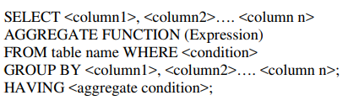
Syntax:

Slide 104
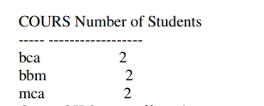
Example:
a. Display the number of students in each course.
mysql> select course, count(*) "Number of Students" from student
-> group by course;

Slide 105
HAVING
The HAVING clause is used in conjunction with the group by clause. It imposes a condition on the group by clause, which further filters the groups created by the group by clause. Each column specification specified in the having clause must occur in the list of columns mentioned in the group by clause.

Slide 106

Example
List the course with more than 1 student.
mysql> select course from student
-> group by course
-> having count(*)>1;

Slide 107

ORDER BY Clause:
The ORDER BY clause is used in a SELECT statement to sort results either in ascending or descending order. Oracle sorts query results in ascending order by default.
Syntax

Slide 108
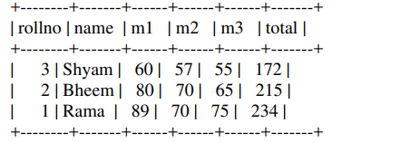
Example:
a. Display the student details in ascending order of marks.
mysql> select * from student order by total;

Slide 109
Sub Queries
A subquery is a form of MYSQL statement that appears inside another MYSQL statement. It is also called a nested query. The statement containing the subquery is called parent query. The parent statement uses the result set returned by the subquery.
It can be used for
• Inserting records in the target table
• Create and insert records in a table
• Update records in target table
• To provide values for conditions in the WHERE, HAVING, IN clause used with SELECT, UPDATE and DELETE commands.

Slide 110
The concept of using a subquery in the FROM clause of the SELECT statement is called inline view. A correlated subquery is one where a subquery references a column from a table in the parent query. A correlated subquery is evaluated once for each row of the parent statement, which can be any of the SELECT, UPDATE or DELETE.

Slide 111
The EXISTS operator is usually used with correlated subqueries. This operator enables to test whether a value retrieved by the outer query exists in the result set of the values retrieved by the inner query. If the subquery returns at least one row, the operator returns true. If the value does not exist, it returns false. The EXISTS operator ensures that the search in the inner query terminates when at least one match is found. The NOT EXISTS operator enables to test whether a value retrieved by the outer query is not a part of the result set of the values retrieved by the inner query.

Slide 112
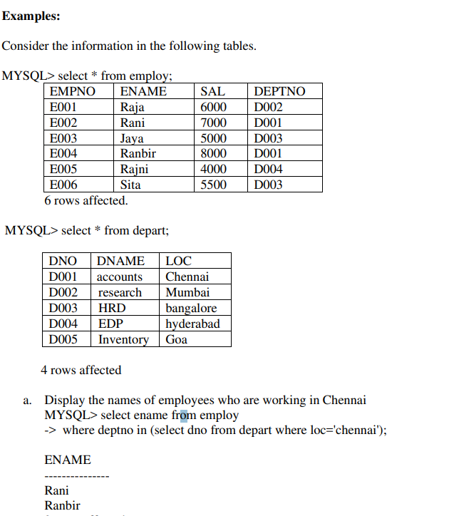

Slide 113
UNION, INTERSECT and MINUS
Union Clause:
Multiple queries can be put together and their output can be combined using the union clause. The union clause merges the output of two or more queries into a single set of rows. Here, the number of columns and the data type of the columns must the same in all the select statements used in the query.

Slide 114
Intersect Clause:
Multiple queries can be put together and their output can be combined using the intersect clause. It outputs only the rows produced by both the queries intersected. The output in the intersect clause will include only those rows that are retrieved common to both the queries. Here, the number of columns and the data type of the columns must the same in all the select statements used in the query.

Slide 115
Minus Clause:
Multiple queries can be put together and their output can be combined using the minus clause. The minus clause outputs the rows produced by the first query, after filtering the rows retrieved by the second query. Here, the number of columns and the data type of the columns must the same in all the select statements used in the query.

Slide 116
Security Management in MYSQL
The rights that allow the use of some or all the resources on the server are called privileges. Objects that are created by the user are owned and controlled by that user. If a user wishes to access any of the objects belonging to another user, the owner of the object will have to give permissions for such access. This is called Granting of Privileges. Privileges once given can be taken back by the owner of the object. This is called Revoking of privileges.

Slide 117

Granting Privileges using the GRANT statement:
The grant statement provides various types of access to database objects. Syntax:

Slide 118
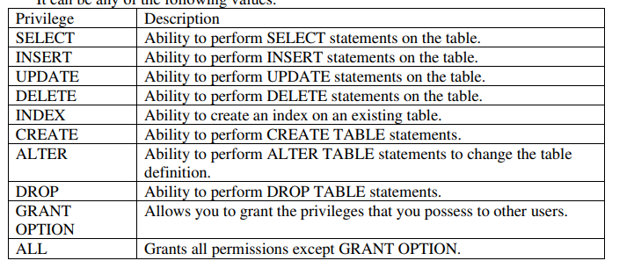
Privileges:

Slide 119
Object
The name of the database objects that you are granting permissions for. In the case of granting privileges on a table, this would be the table name.
User : The name of the user that will be granted these privileges.

Slide 120

Revoking Privileges:
Privileges once given can be denied to the user using the REVOKE command. The object owner can revoke privileges granted to another user.

Slide 121
Joins
There are occasions where we need to retrieve data from multiple tables. This is achieved in MYSQL using joins. Tables are joined on columns that have same data type and data width in the tables. The tables are related with the help of primary key and foreign keys of the table.
The different types of joins are
• INNER JOIN
• OUTER JOIN
• CROSS JOIN
• SELF JOIN

Slide 122
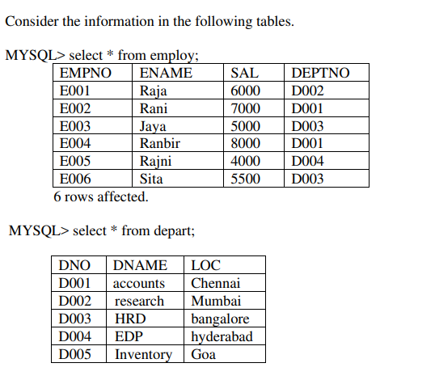
Example

Slide 123
INNER JOIN
These joins are also called equi joins. They are known as equi joins because the where clause compares two columns using the = operator. It is the most commonly used operator. It returns all the rows from both the tables where there is a match.

Slide 124
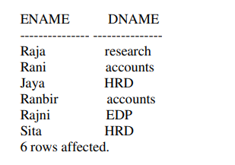
a. Display the names of employees and the department in which they work
MYSQL> select ename,dname from employ, depart where employ.deptno=depart.dno;

Slide 125
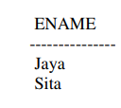
b. Display the names of employees working in HRD department
MYSQL> select ename from employ, depart where employ.deptno=depart.dno and dname='HRD';

Slide 126
CROSS JOIN
A cross join returns the Cartesian product. This means that the join combines every row from the left table with every row in the right table.

Slide 127
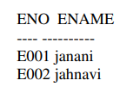
Example:
MYSQL> select * from sam1;

Slide 128
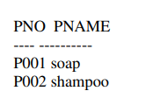
Example:
MYSQL> select * from sam2;

Slide 129
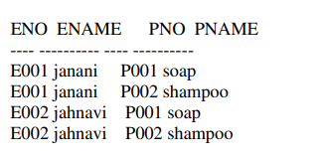
Illustrate a cross join operation on sam1 and sam2
MYSQL> select eno,ename,pno,pname from sam1 cross join sam2;

Slide 130
OUTER JOIN
This type of join can be used in selecting rows from both the tables regardless of whether the tables have common values or not. NULL values are appended in the result set where the data is missing.

Slide 131
LEFT OUTER JOIN
For left outer join use a LEFT JOIN keyword which returns all records from the left table (table1), and the matching records from the right table (table2). The result is NULL on the right side, if there is no match. Note: In some databases LEFT JOIN is called LEFT OUTER JOIN.

Slide 132
Syntax for Left outer join
SELECT column_name(s)
FROM table1
LEFT JOIN table2 ON table1.column_name = table2.column_name;

Slide 133
RIGHT OUTER JOIN
For right outer join use a RIGHT JOIN keyword which returns all records from the right table (table2), and the matching records from the left table (table1). The result is NULL on the left side, if there is no match. Note: In some databases RIGHT JOIN is called RIGHT OUTER JOIN.

Slide 134
Syntax for Right outer join
SELECT column_name(s)
FROM table1
RIGHT JOIN table2
ON table1.column_name = table2.column_name;

Slide 135
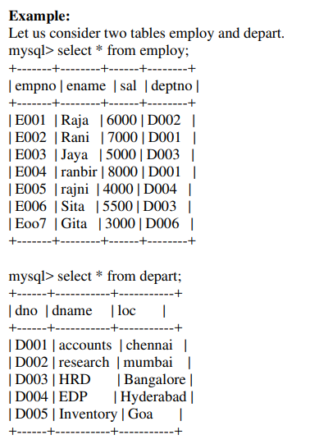

Slide 136
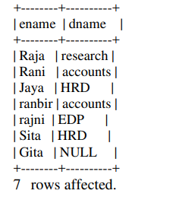
Display the employee name and department using left outer join.
MYSQL> select employ.ename,depart.dname from employ left join depart on employ.deptno=depart.dno;

Slide 137
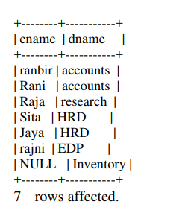
Display the employee name and department using right outer join.
MYSQL> select employ.ename,depart.dname from employ right join depart on employ.deptno=depart.dno;

